Slide 1
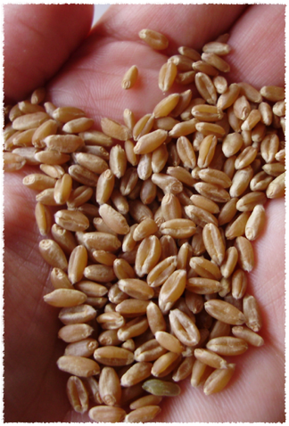
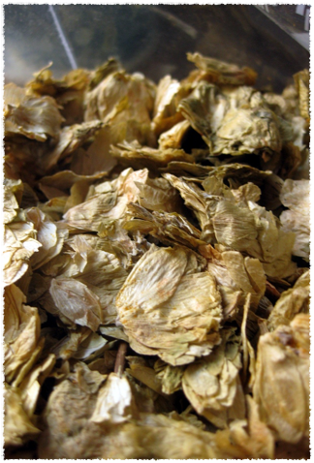
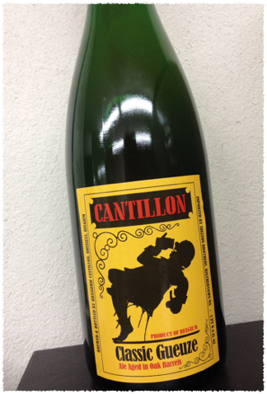
Turbid Mashing for Sour Beers
By Matt Sager & Vito Delucchi
(another abysmal powerpoint presentation)

Slide 2
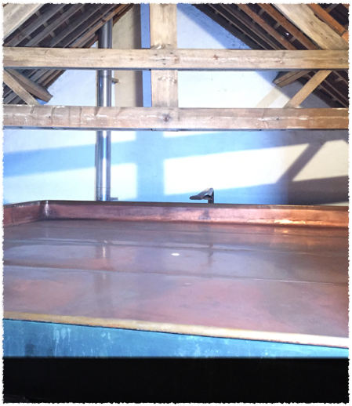
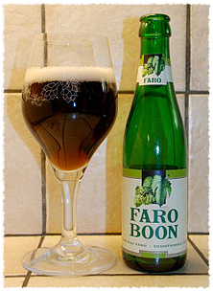

What is Lambic?
Remains a controlled appellation.
Brewed within 15 kilometers of Brussels in the Senne River Valley (Pajottenland)
30-40 percent wheat
Aged hops
Open fermentation
Types
Lambic
Faro
Gueuze
Fruit Lambic

Slide 3
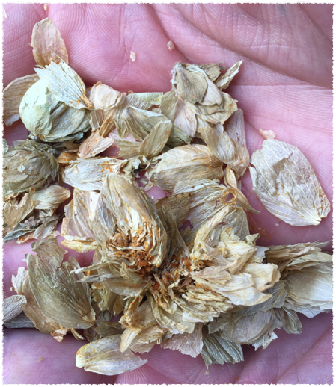
What is a turbid mash, and why bother?
Traditionally, it was a way to produce relatively higher gravity wort in smaller mash tuns (in response to taxation based on the size of mash tuns).
A method of mashing, so that a large portion of dextrins remain in the wort.
Highly attenuative wild yeasts and bacteria find the resulting dextrins desirable.

Slide 4
Our Recipe for a 10 Gallon Batch
12 lbs Belgian pilsner malt
7 lbs unmalted hard red winter wheat
1 lb rice hulls
6 oz aged whole leaf hops (not to exceed ~5 IBU)
yeast/bacteria from various sources
OG: 1.050

Slide 5
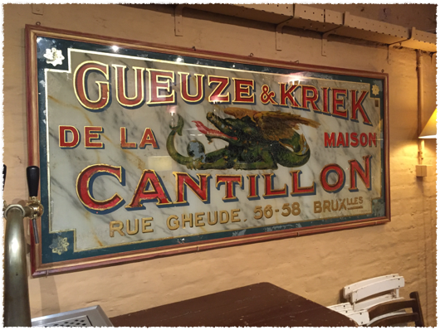
Overview of Process
Thick rest at 113F
Add boiling water for rest at 126F
Draw off turbid wort, hold at 180F
Add boiling water for rest at 150F
Draw off turbid wort, hold at 180F
Add boiling water for rest at 162F
Draw off turbid wort, hold at 180F
Add turbid wort to mash for rest at 170F
Sparge with 190F
Boil, adding aged hops
Pitch “bugs”

Slide 6
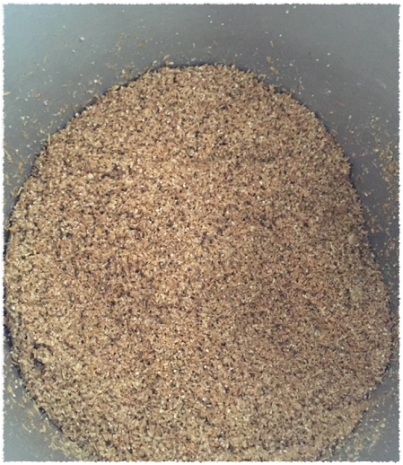
Step by Step Method
1) Mash in VERY thick!
0.3 qts liquor per lb grain
Rest at 113 F for 15 min.

Slide 7
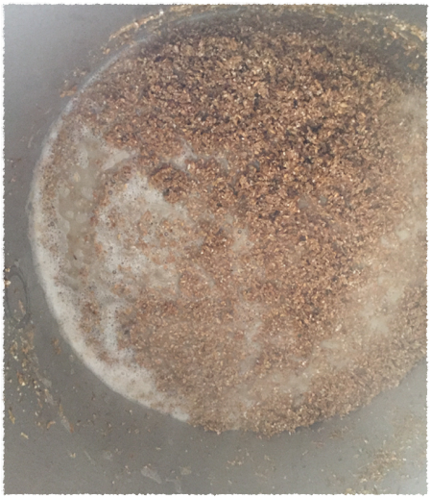
2) Slowly add boiling water to mash, to bring to 126 F. Rest for 10 minutes.

Slide 8
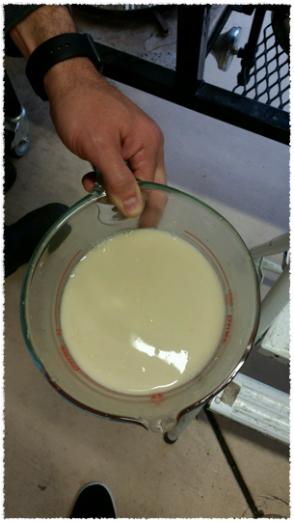
3) Draw off 2 qts wort in a pot.
Heat and hold at 180 F

Slide 9
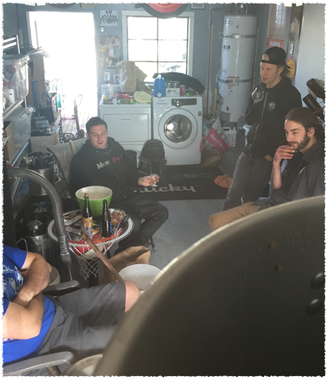
4) Slowly add boiling water to mash, to bring to 150F. Rest for 30 minutes.
5) Draw off 2 gal. wort into pot (from step 3). Heat and hold at 180F.

Slide 10
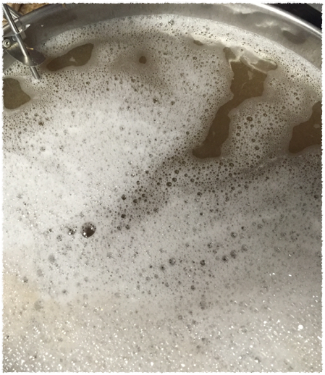
6) Slowly add boiling water to mash, to bring to 162F. Rest for 20 minutes.
7) Draw off 2.5 gal. wort and add to pot (from steps 3 & 5). Heat and hold at 180F.

Slide 11
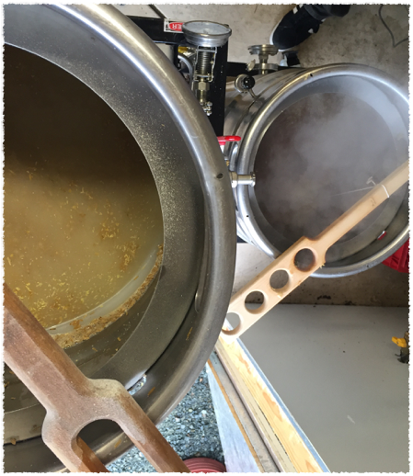
8) Add heated wort from pot to mash.
This should result in 172F.
Hold for 20 min.

Slide 12
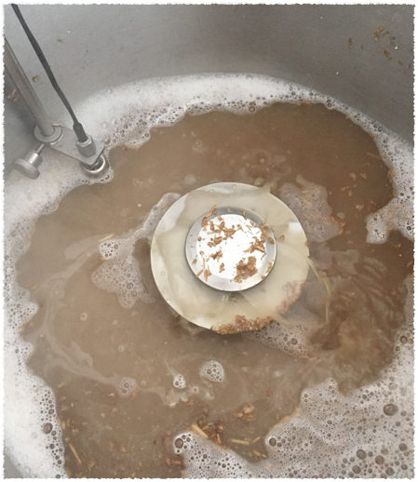
9) Vorlauf & sparge with 190F liquor.
Why so hot??

Slide 13
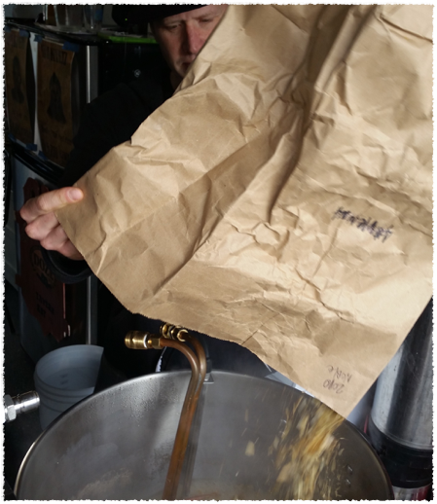
10) Add old hops and boil for 90 minutes.
Why so old??

Slide 14
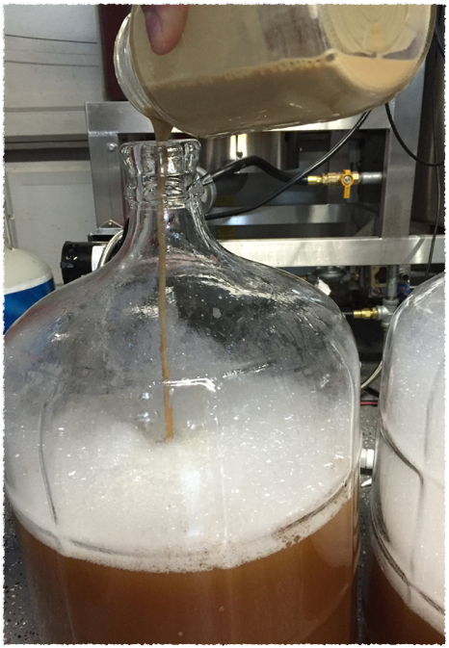
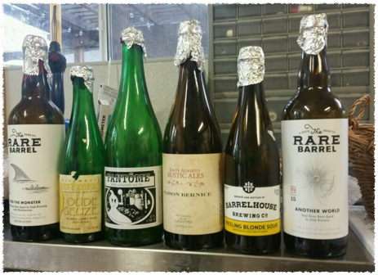
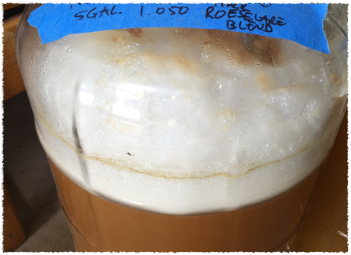

Slide 15
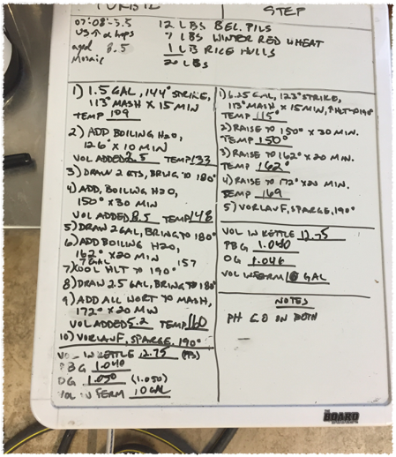
So, is it worth the effort?
We brewed back-to-back batches. (turbid & step)
Issues we encountered…

Slide 16

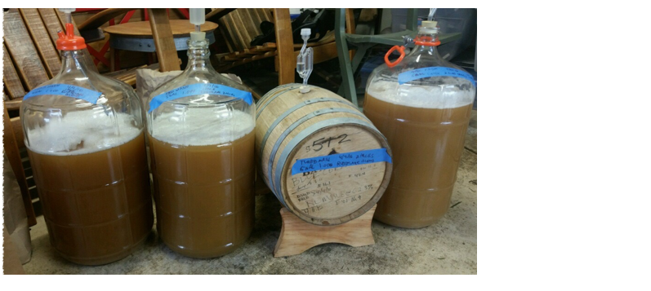
1 turbid carboy with Roeselare blend
1 step carboy with Roeselare blend
1 turbid carboy with dregs
1 step oak barrel with Roeselare blend.

Slide 17
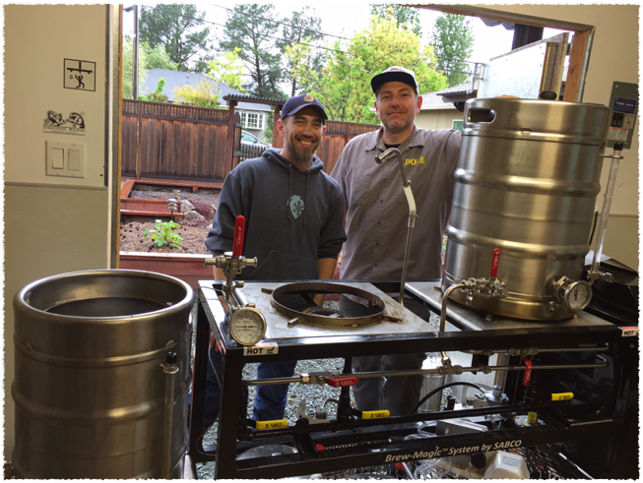
Stay Tuned for Results!

Slide 18
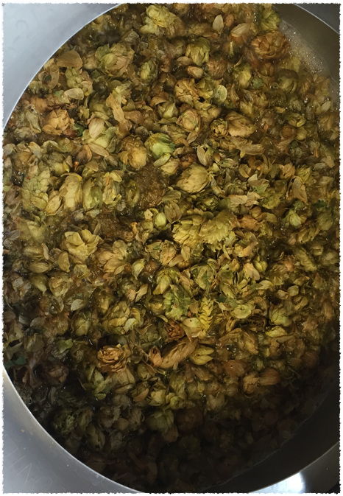
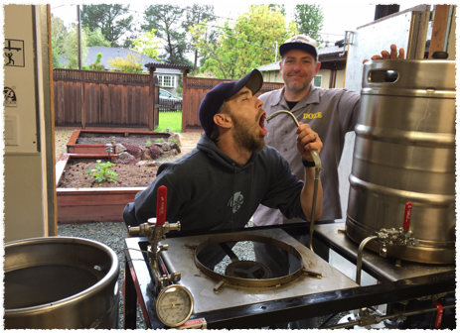
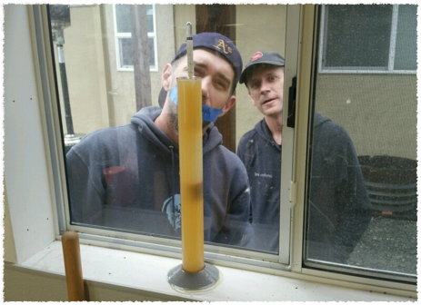
Questions?

